Slide 1

cropify
GOKARAJU RANGARAJU INSTITUTE OF ENGINEERING AND TECHNOLOGY
Bachupally, Kukatpally, Hyderabad - 500090
DEPARTMENT OF INFORMATION TECHNOLOGY
MINI PROJECT ABSTRACT PRESENTATION
ON
BATCH No. 7
Dhavaleswarapu Anudeep 18241A1215
Potluri Sai Sampath 18241A1249
Tejaswi Krishna Kosaraju 16241A12B1
P Parasuram 18241A1244
Under the guidance of
Project Guide
Head of the Department
V. Padma
Associate Professor
Dr. K Prasanna Lakshmi

Slide 2
CONTENTS
Introduction
Abstract
Existing System and its drawbacks
Proposed System and its advantages
Project Architecture
Hardware/Software Requirements
Conclusion

Slide 3
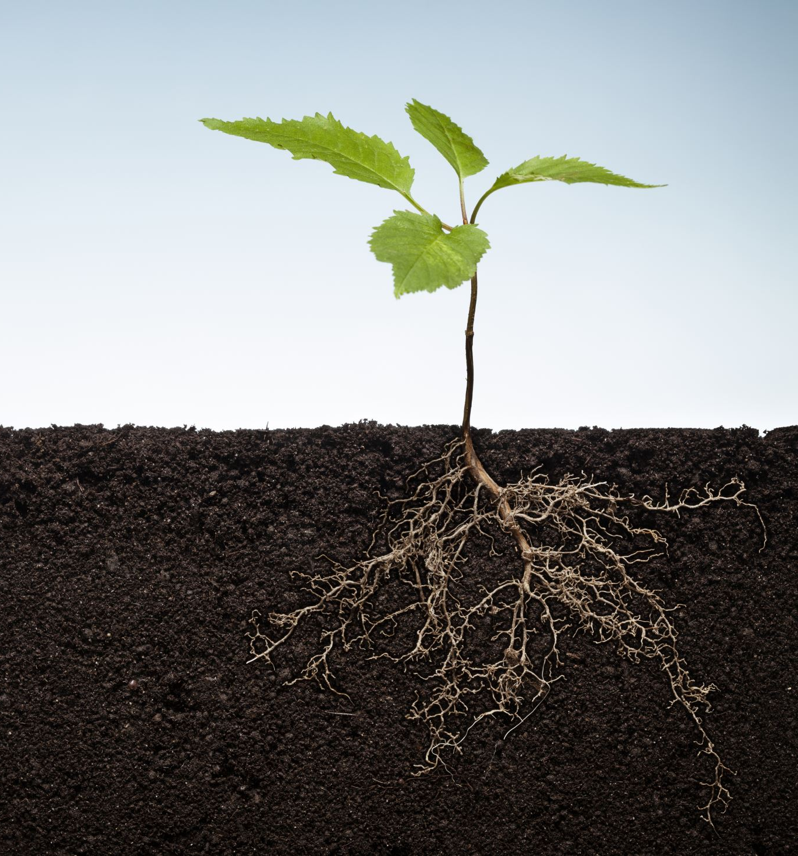
Farmers don’t generally know the chemicals levels of the soil and use fertilizers and choose unsuitable crops.
The idea of this project is to solve this issue by predicting the best crop for the given conditions.
Additionally, the total yield will also be predicted.
INTRODUCTION

Slide 4
ABSTRACT
Specific sensors are used to gather data.
These are integrated with an Arduino board.
Setup installed in the farm sends the data to the local server.
We pass this data to a model which predicts the outcome.
Predicted crop and its yield are shown on a webpage.

Slide 5
EXISTING SYSTEM
Chemical Analysis of soil is performed.
Results are passed to a model for prediction.
It provides the suitable crop for the soil type.

Slide 6
DRAWBACKS OF EXISTING SYSTEM
Heavy architecture.
Since temperature and humidity are not being considered, the predicted crops may be inaccurate.
Uses LORA which is useful for long range transmission, but equipment is costly.
Farmers should have in depth knowledge for using this system.

Slide 7
PROPOSED SYSTEM
In this system, we place an Arduino board connected with the soil moisture sensor, DHT11 sensor and a Wi-Fi module.
This setup is placed in the farm where the soil analysis is required.
The Wi-Fi module is used to send the moisture, temperature and humidity data back to the local server.

Slide 8
PROPOSED SYSTEM
This data is accessed and is passed to a ML model which is created using KNN and regression algorithms.
This is supervised leaning as we train the model using predefined dataset.
The predicted crop and its yield are displayed on a webpage which we create.

Slide 9
ADVANTAGES OF PROPOSED SYSTEM
Less equipment is used.
Soil moisture, temperature and humidity are also considered.
Suitable crop along with its yield is predicted.
Wireless network is used which is faster and cheaper.
Accurate predictions

Slide 10
PROJECT ARCHITECTURE
SOIL MOISTURE LEVELS
ARDUINO UNO BOARD
EMBEDDED SERVER
PREDEFINED DATASET
SENSOR DATA
TEMPERATURE AND HUMIDITY LEVELS
WI-FI MODULE
PASS THE
CURRENT INPUTS
DISPLAY ON WEBPAGE
PREDICTION
MODEL
PASS THE RESULTS

Slide 11
REQUIREMENTS
Hardware
ARDUINO UNO
DHT11 SENSOR
SOIL MOISTURE SENSOR FC-28
ESP8266WIFI MODULE
ESSENTIAL WIRES
Software
JUPYTER NOTEBOOK
ARDUINO SOFTWARE
FLASK
HTML + CSS + JS

Slide 12
conclusion
In India, lot of farmers are using fertilisers on the soil without having an idea about it.
This pollutes the soil and makes it unusable after a long period of time.
Some plant a wrong crop in wrong season which will not give them favourable yield.
Our project tries to solve this problem in a simple and efficient manner.

Slide 13
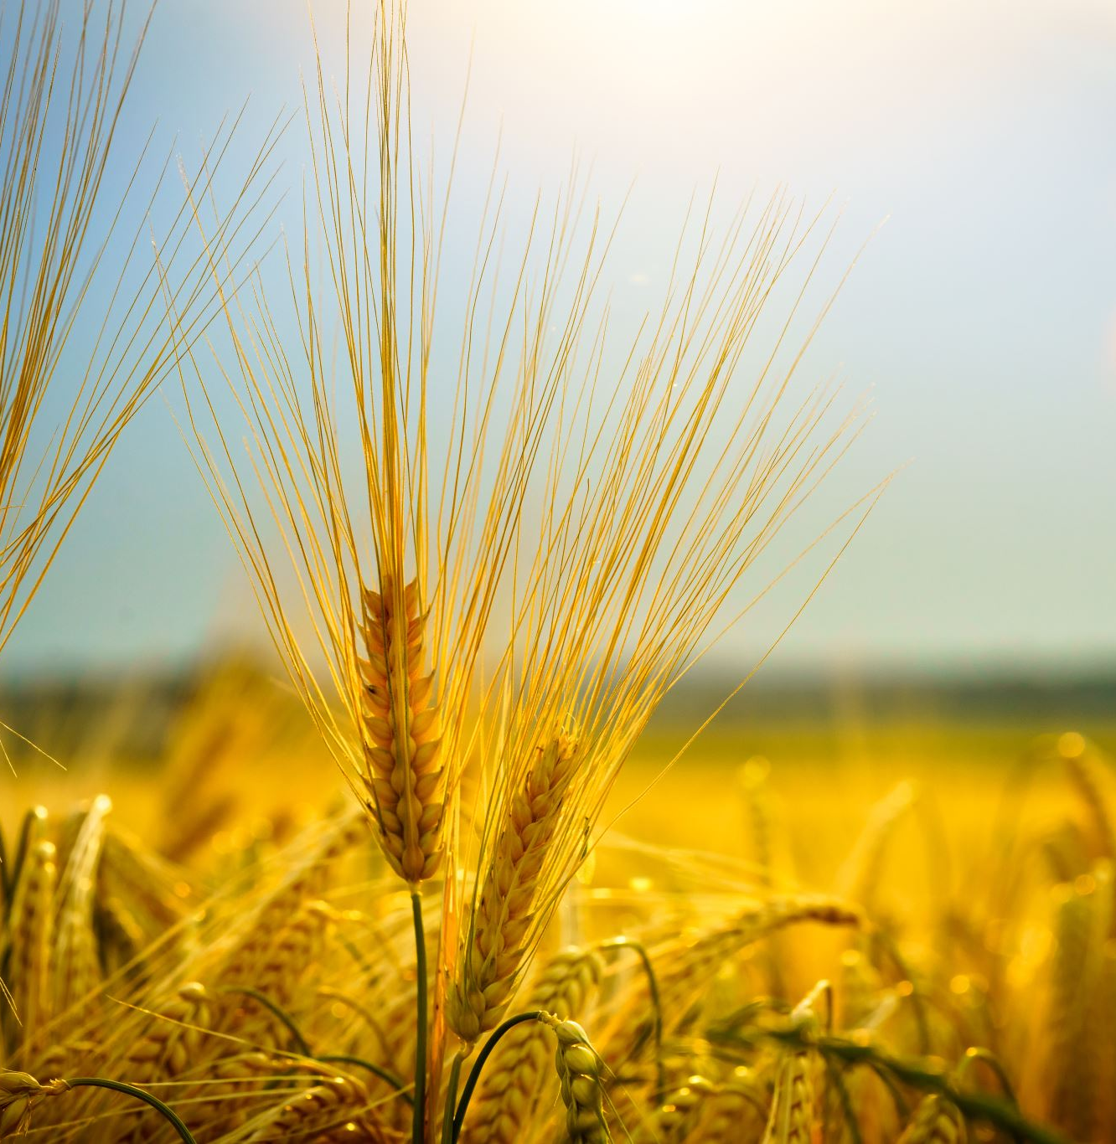
THANK YOU

Slide 14
ANY QUERIES?

